Slide 1
Bayesian Inference
Module 2, Lesson 2
Notes:
Welcome to lesson 2 of module 2 of Baysian inference

Slide 2
Priors
Shahrzad Jamshidi, PhD
Notes:
In this lesson, we will discuss priors.

Slide 3
Last Time
Bernoulli trials, binomial distributions
The posterior is a balance between the prior and the data
We discussed methods to summarize the posterior distribution and to make predictions.
Notes:
Last time, we computed an example with Bernoulli trials, modeling it with a binomial distribution and a uniform prior. Our result was a beta distribution.
With this example, we discussed how the posterior is a balance between the prior distribution and the data collected. The larger our dataset, the heavier its influence on our posterior.
We also discussed methods to summarize the posterior distribution and make predictions.

Slide 4
Objective
Define conjugate prior distributions.
Differentiate between informative, noninformative, and weakly informative priors.
Notes:
By the end of this lesson, you should be able to
define the conjugate prior distribution, and
Differentiate between informative, noninformative, and weakly informative priors.

Slide 5
Topics to Review
Beta distributions
Normal distributions

Slide 6
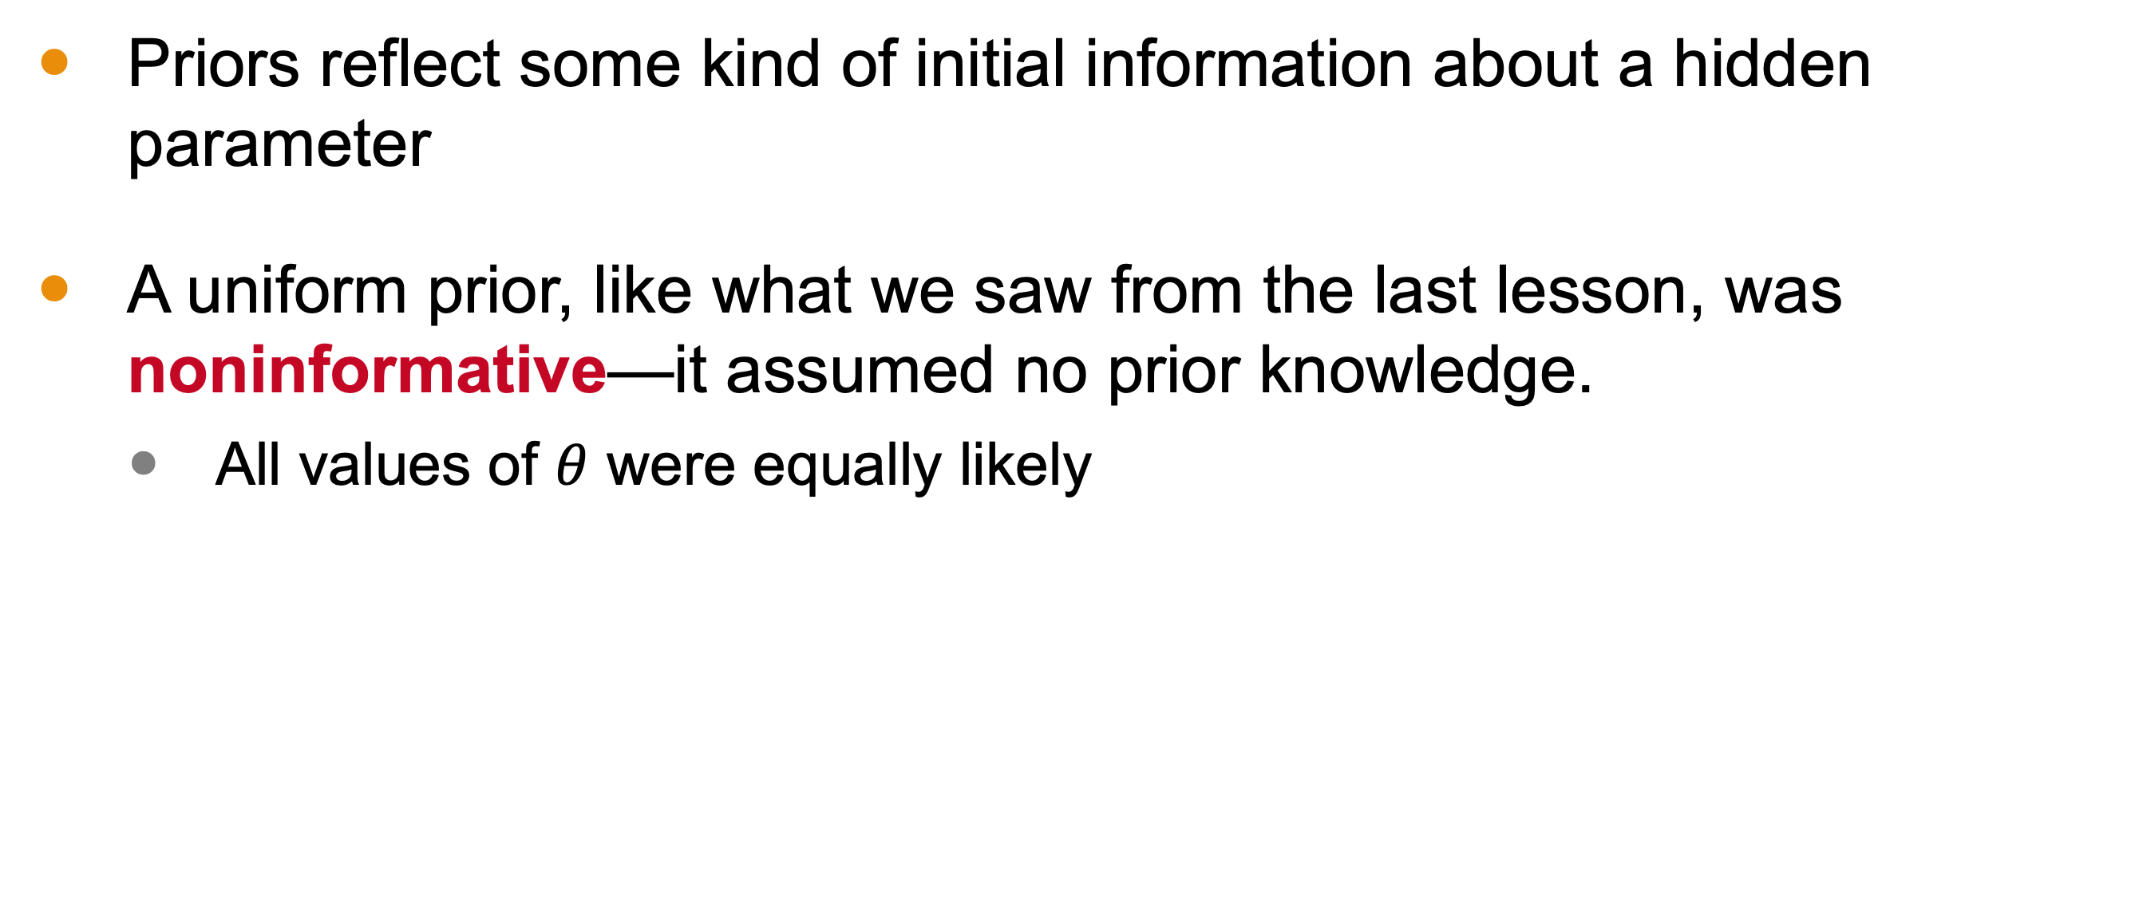
Noninformative Priors
Priors reflect some kind of initial information about a hidden parameter
A uniform prior, like what we saw from the last lesson, was noninformative—it assumed no prior knowledge.
All values of $θ$ were equally likely
Notes:
Priors are a reflection of some kind of initial information we have about a hidden parameter we are estimating.
A uniform prior, like the one from lesson1 of this module, was noninformative. For it, we assumed no prior knowledge—all the values of theta were equally likely.

Slide 7
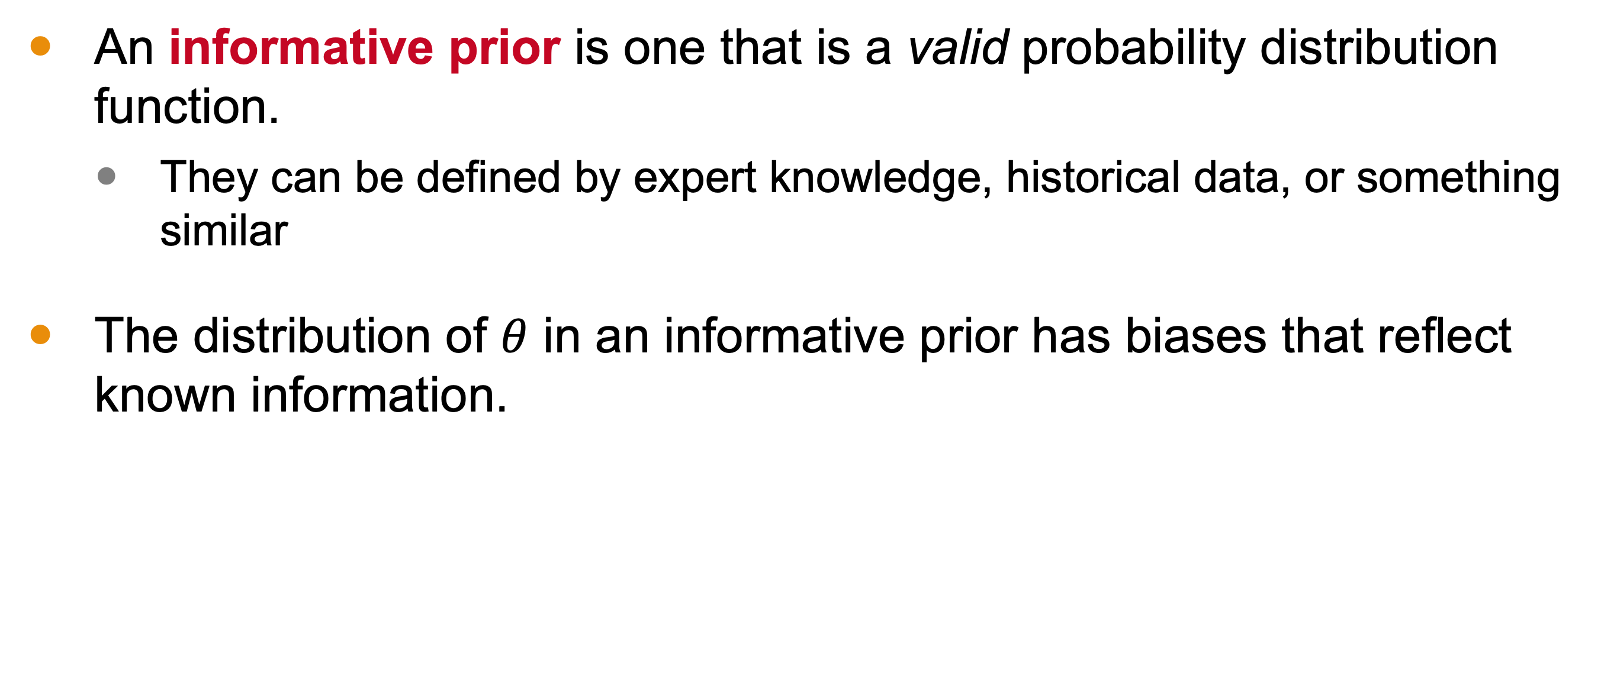
Informative Priors
An informative prior is one that is a valid probability distribution function.
They can be defined by expert knowledge, historical data, or something similar
The distribution of $θ$ in an informative prior has biases that reflect known information.
Notes:
An informative prior, on the other hand, is one that is a valid probability distribution.
By this, we mean that it is defined by information at hand, such as expert knowledge, historical data or something similar.
The distribution for theta in an informative prior is essentially one where the biases reflect known information.

Slide 8
Prior Interpretations
There are two primary interpretations of prior distributions:
Population Interpretation: The prior distribution represents a population of possible parameter values.
State of Knowledge Interpretation: The prior reflects our current knowledge and uncertainty about the parameter, treating its value as a random realization from the prior distribution.
Precise population of parameter values may not exist.
The prior should encompass all plausible values.

Slide 9
Construction of Prior Distributions
The construction of prior distributions involves
incorporating all plausible values of the parameter and
using prior knowledge to guide the shape and concentration of the distribution.
Notes:
Prior distributions are constructed from
All plausible values of the parameter
And some prior knowledge to bias more heavily toward some of those values over others. Let’s look at an example.

Slide 10

Example
Suppose we are interested in estimating the probability of a manufacturing defect in a car part. Historical data from the part suggest that the defect rate is typically low, around 5%. However, there is some uncertainty due to differences in manufacturing processes. Based on the data, the variance is roughly 0.25%.

Slide 11
Example
Suppose we are interested in estimating the probability of a manufacturing defect in a car part. Historical data from the part suggest that the defect rate is typically low, around 5%. However, there is some uncertainty due to differences in manufacturing processes. Based on the data, the variance is roughly 0.25%.

Slide 12
Example
Suppose we are interested in estimating the probability of a manufacturing defect in a car part. Historical data from the part suggest that the defect rate is typically low, around 5%. However, there is some uncertainty due to differences in manufacturing processes. Based on the data, the variance is roughly 0.25%.

Slide 13
On a More Abstract Level
The choice of prior distribution will influence the posterior distribution.
In lesson 1, we looked at an example where the prior distribution was uniform for Bernoulli trials.
We can reconsider this example, but with different priors.

Slide 14
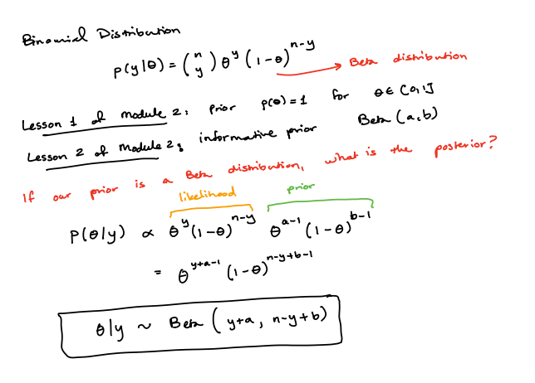

Slide 15
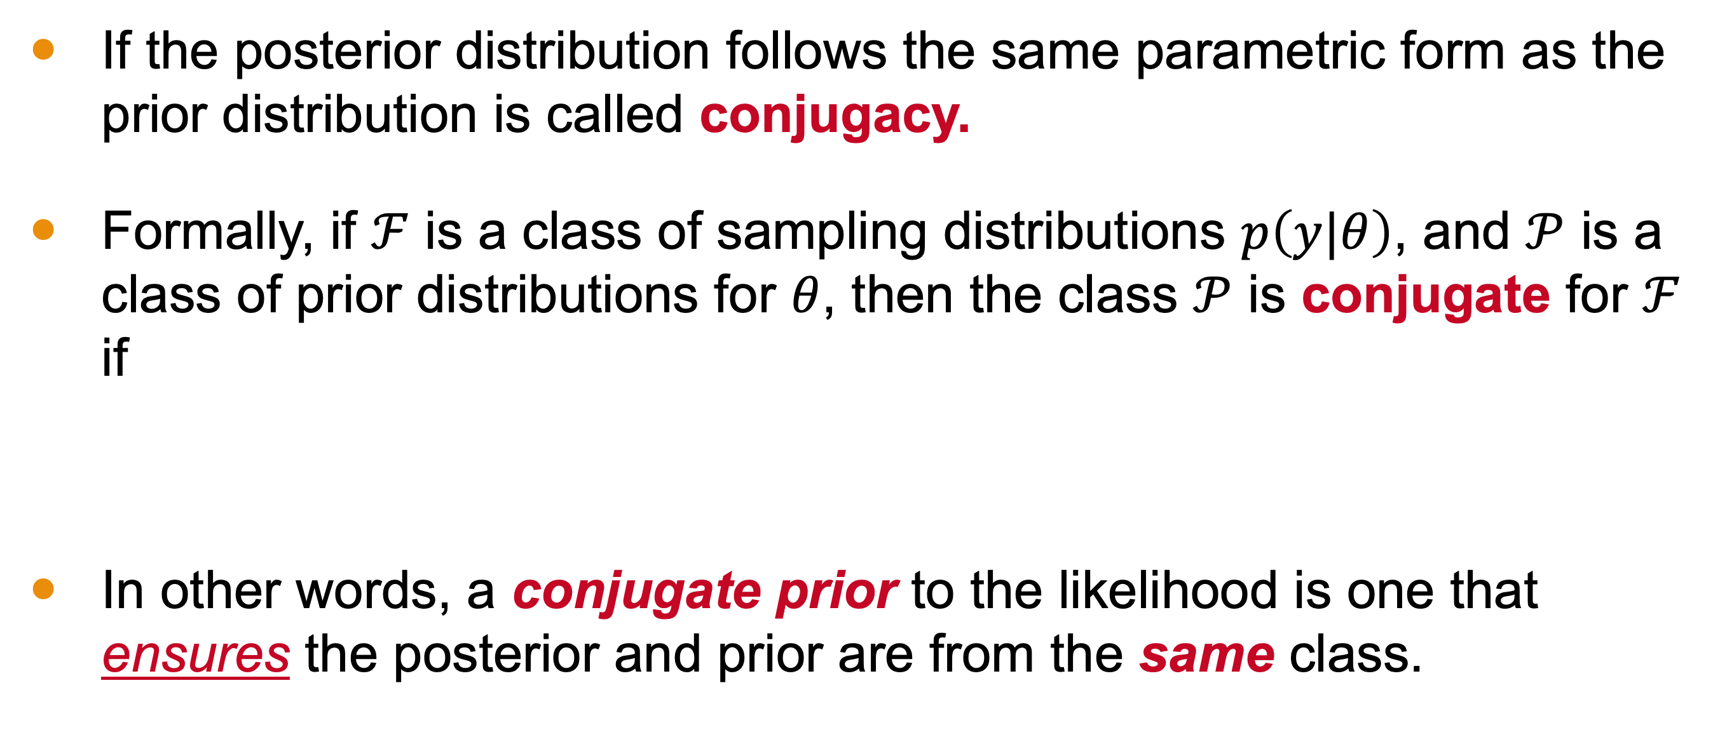
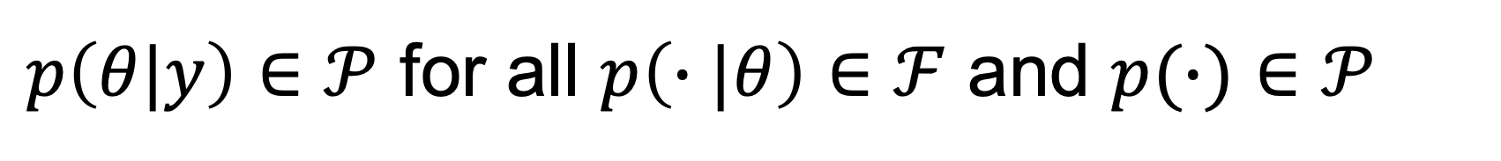
Conjugate Prior Distribution
If the posterior distribution follows the same parametric form as the prior distribution is called conjugacy.
Formally, if $ℱ$ is a class of sampling distributions $p\left(y|θ\right)$, and $𝒫$ is a class of prior distributions for $θ$, then the class $𝒫$ is conjugate for $ℱ$ if
In other words, a conjugate prior to the likelihood is one that ensures the posterior and prior are from the same class.
$p\left(θ|y\right)∈𝒫$ for all $p\left(∙|θ\right)∈ℱ$ and $p(∙)∈𝒫$
Notes:
Conjugacy is an important notion in Bayesian statistics.
Whenevr the posterior distribution is the same kind of distribution as the prior (perhaps with different parameters, but part of the same “class”), we call them conjugate.
Formally, let F be our class of sampling distributions (the type of functions our likelihood comes from) and let P be the class of prior distribution, then we say P is conjugate to F if the posterior is in P for all choice of likelihood in F and prior in P.
In our example, we were using a conjugate prior because our posterior, a beta distribution, was in the same family as the prior we used.
Put another way, we say that a prior is conju

Slide 16
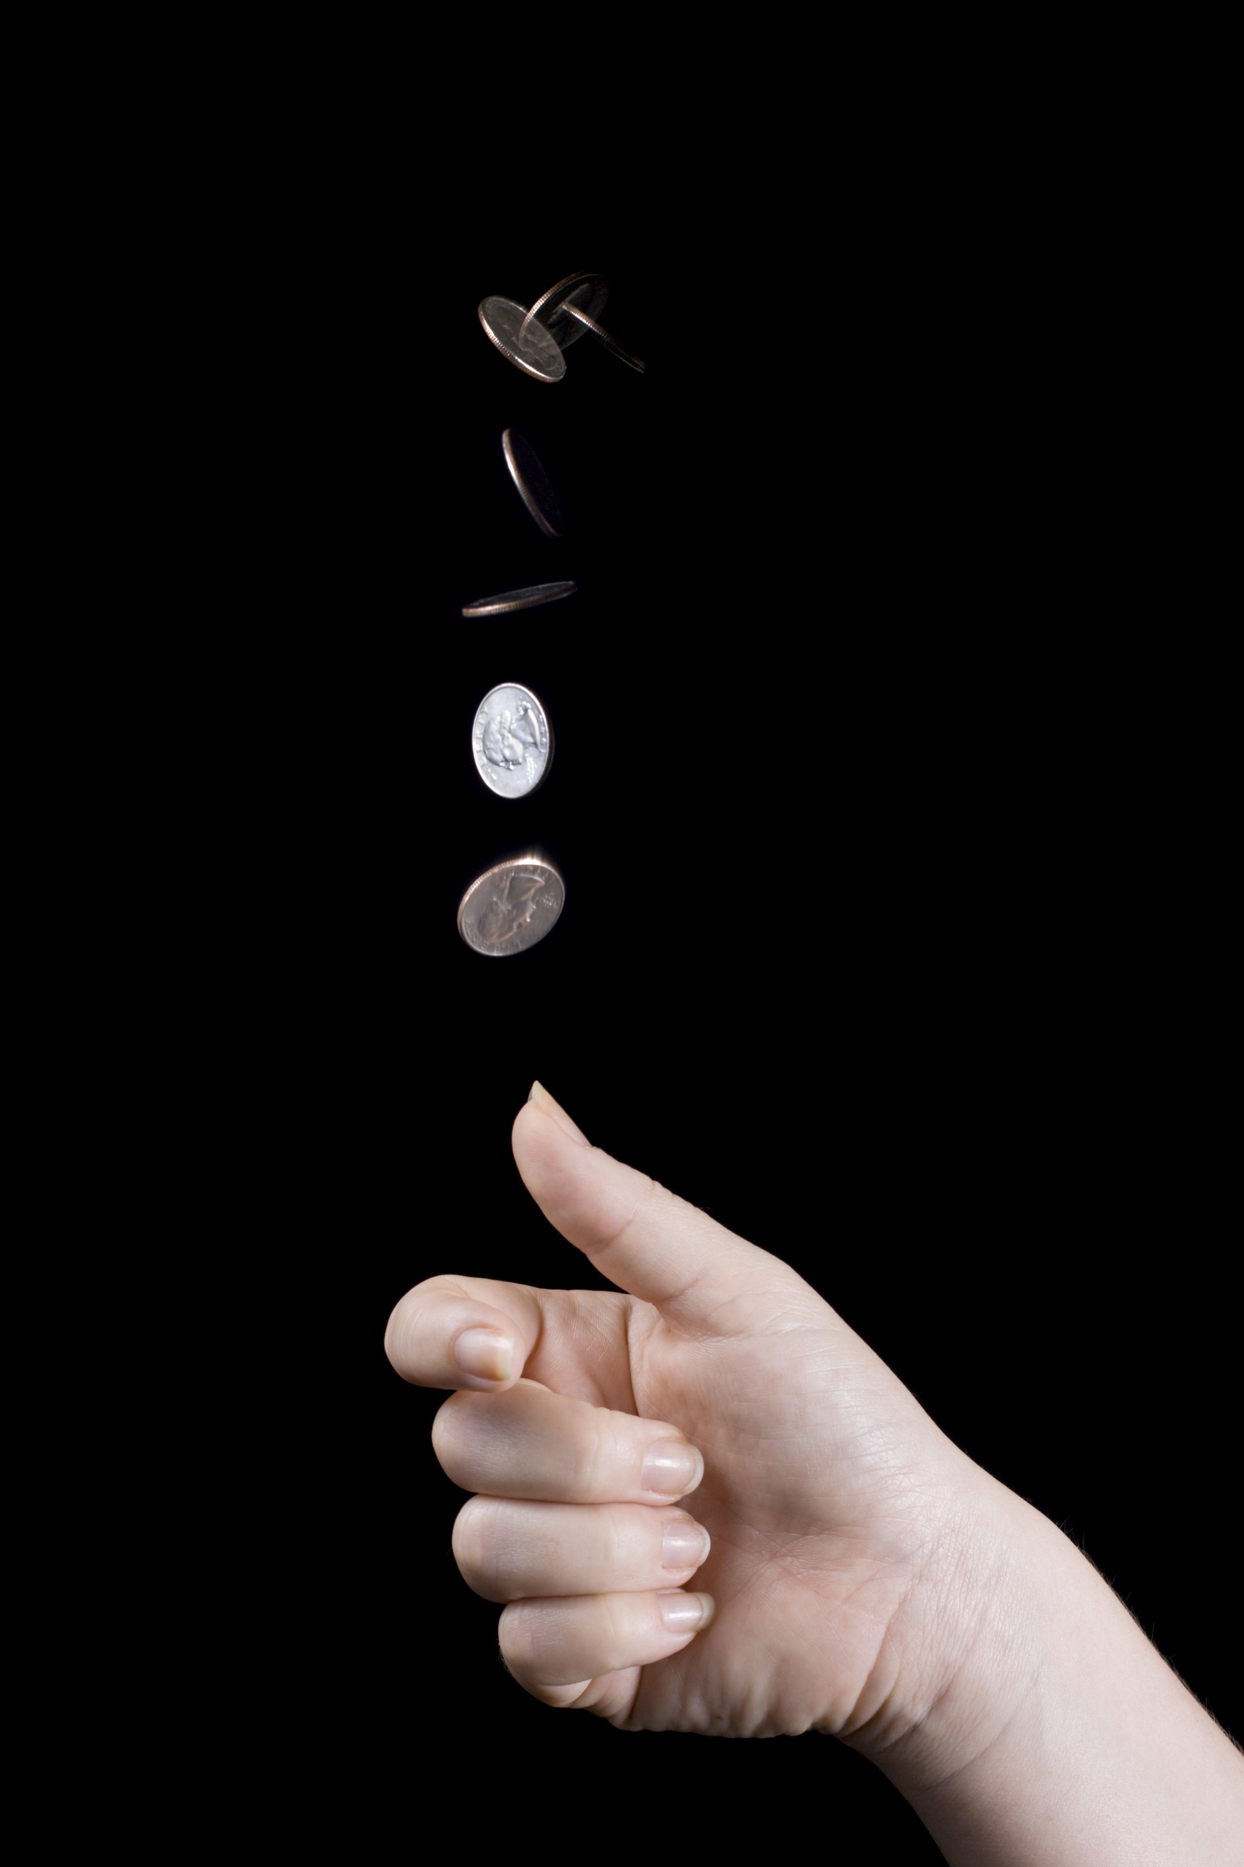
Conjugate Example
In Scientific American, the article Scientists Destroy Illusion That Coin Toss Flips Are 50–50 (Jan. 2024 by Shi En Kim)
“The leading theory explaining the subtle advantage comes from a 2007 physics study by Stanford University statistician Persi Diaconis and his colleagues, whose calculations predicted a same-side bias of 51 percent.”
Let’s walk through an imaginary scenario based on this work.
iStock-156210661 credit - alexeys
Notes:
So here is an interesting, real world finding. Flipping coins is not 50-50. Technically, there is a slight bias toward heads.
Let’s now do an example that illustrates how easy conjugates can be using this example.

Slide 17
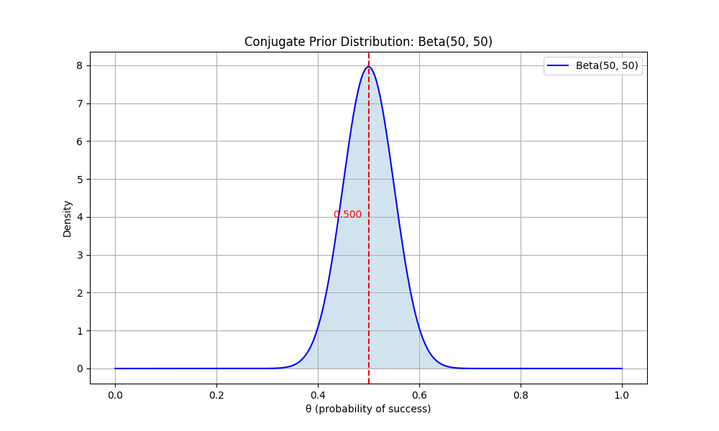
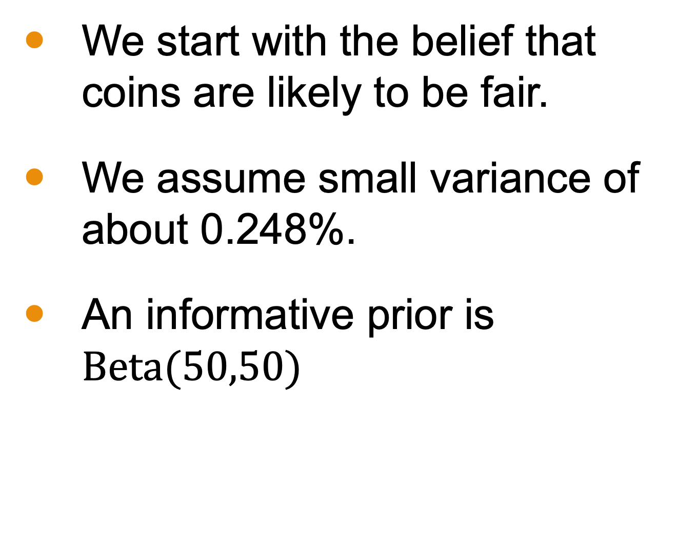
Example Prior
We start with the belief that coins are likely to be fair.
We assume small variance of about 0.248%.
An informative prior is $\text{Beta}(50,50)$
Notes:
Suppose we are attempting to replicate the work previously discussed. We start with a prior belief that coins are fair with a small variance, say 0.248%. This is the. Basis of our prior—much like our first example of an informative prior.
I leave it as an exercise to solve for a and b.

Slide 18
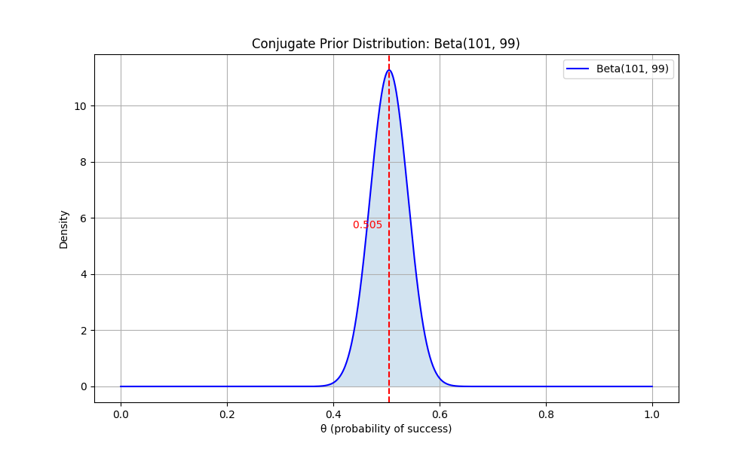
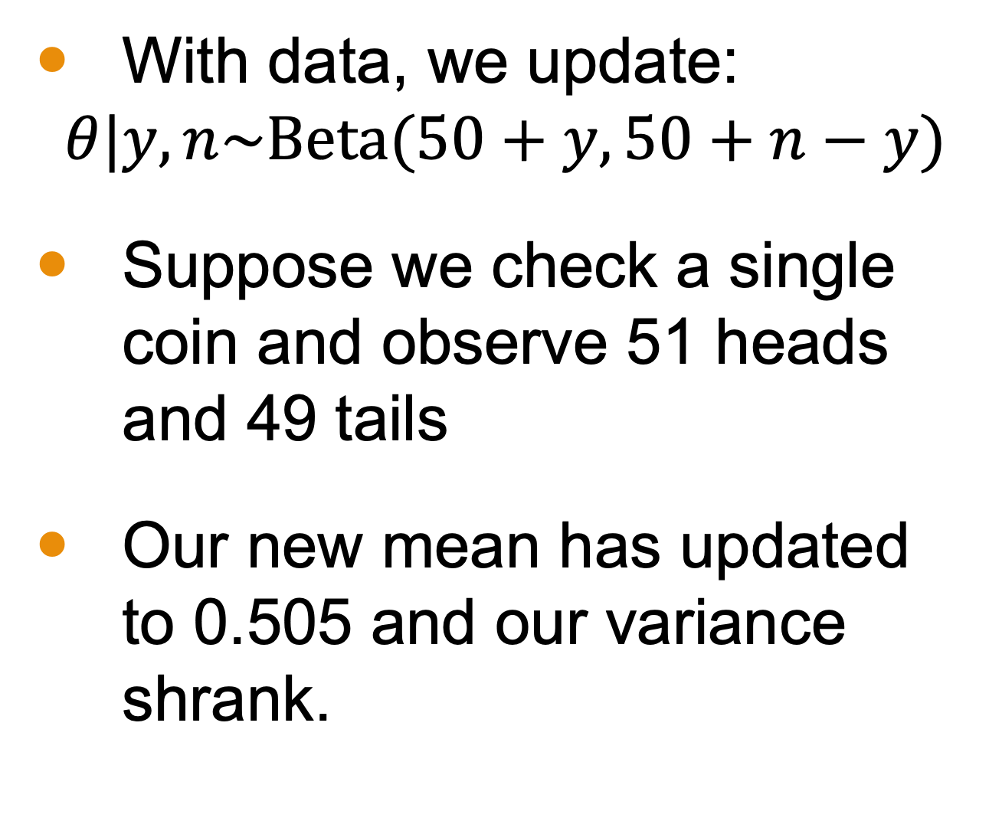
Resulting Posterior
With data, we update:
$$θ|y,n\sim \text{Beta}(50+y,50+n−y)$$
Suppose we check a single coin and observe 51 heads and 49 tails
Our new mean has updated to 0.505 and our variance shrank.

Slide 19
Nonconjugate Prior Distributions
Conjugate prior distributions are analytically “nice”.
Our last example was easy to do!
In practice, conjugate priors may not be possible.
Nonconjugate prior distributions, however, do not pose any new conceptual problems.

Slide 20
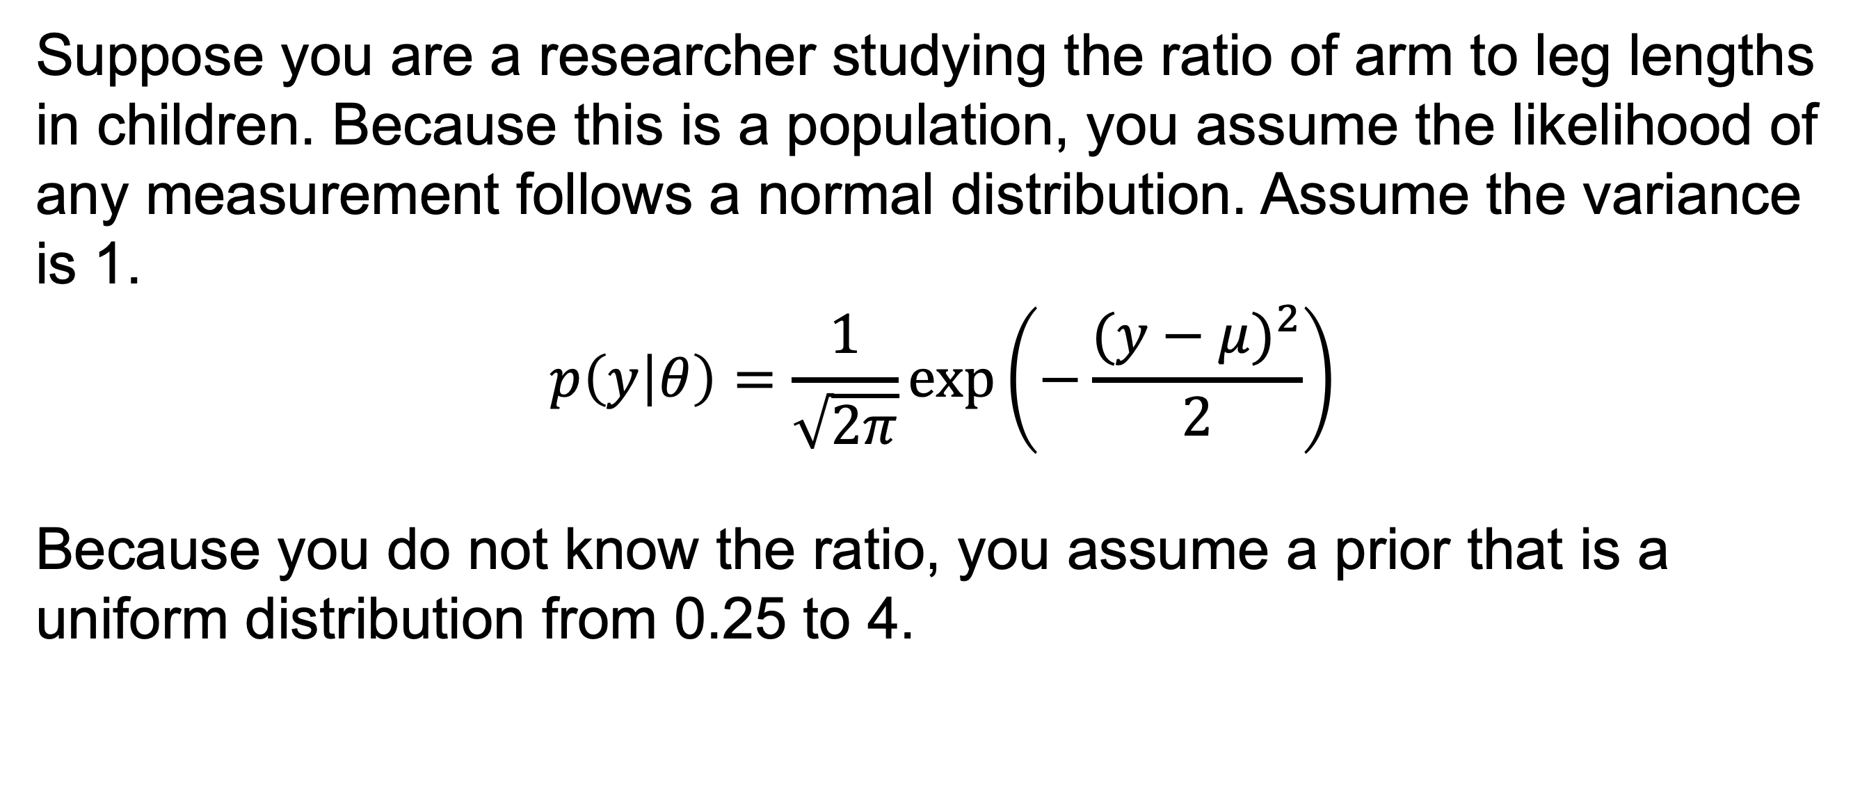
Nonconjugate Example
Suppose you are a researcher studying the ratio of arm to leg lengths in children. Because this is a population, you assume the likelihood of any measurement follows a normal distribution. Assume the variance is 1.
$$p\left(y | θ\right)=\frac{1}{\sqrt{2π}}exp⁡\left(−\frac{{(y−μ)}^{2}}{2}\right)$$
Because you do not know the ratio, you assume a prior that is a uniform distribution from 0.25 to 4.

Slide 21
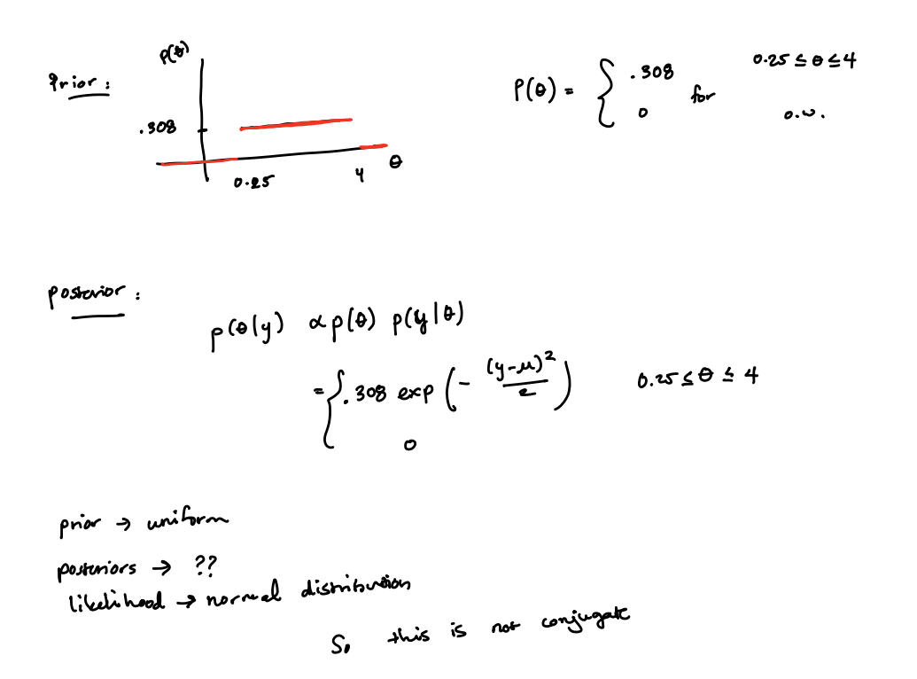
Notes:
Nonconjugate example

Slide 22
Weakly Informative Prior
We’ve discussed informative priors that are conjugate and nonconjugate.
Noninformative are flat, uniform distributions of the parameter, showing no bias to to any values.
Weakly informative priors are constructed so that prior knowledge is used but it is intentionally weaker than what is actually known.

Slide 23
Constructing a Weakly Informative Prior
Two main methods:
Start with a noninformative prior distribution and then add enough information so that inferences are constrained to be reasonable.
Start with a strong, highly informative prior and broaden it to account for uncertainty.

Slide 24
Next Time
More examples of distributions

